Slide 1
DNA Sequen cing
Lecture – 4
Taslima Ferdaus Shuva, Sr. Lecturer, Department of CSE, DIU

Slide 3
CONTENTS
DNA Sequencing
First Gen Sequencing -Sanger Method (1977)
Second / Next Gen Sequencing - 454/Roche (2005) - ABI SOLiD (2006) - Illumina/Solexa (2007)
Third / Next-Next Gen Sequencing - Pacific Biosciences (PacBio) - Oxford Nanopore
Miscellaneous Terms

Slide 4
1. DNA Sequencing
Determining nucleotide sequences

Slide 5
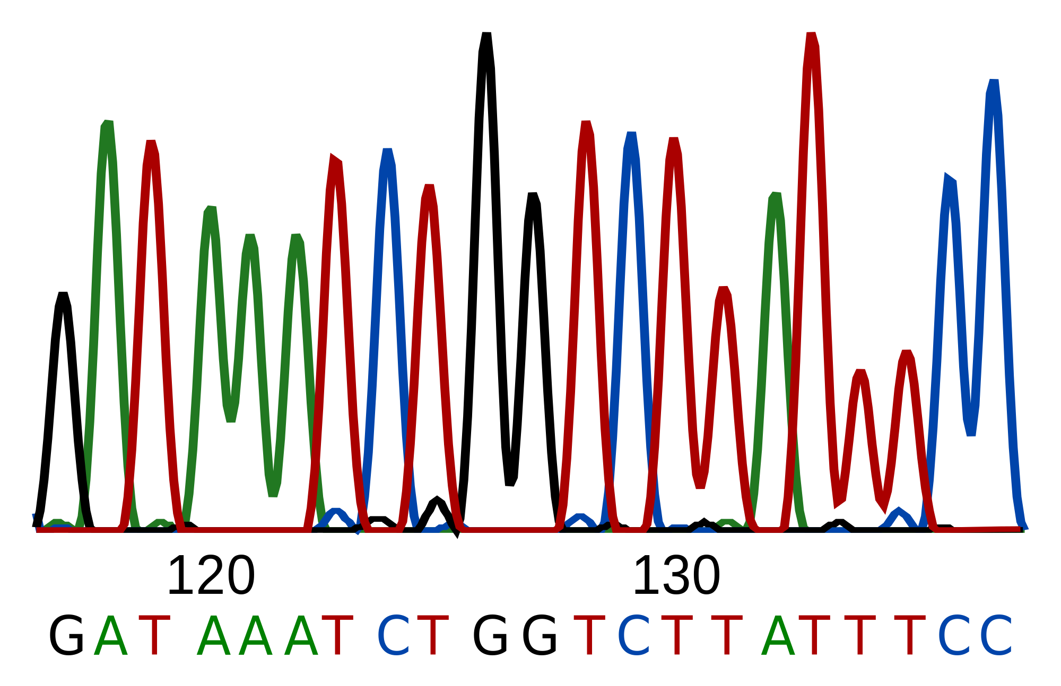
DNA Sequencing
DNA sequencing is the process of determining the precise order of nucleotides (A, T, G, C) within a DNA molecule.

Slide 6
2. First Generation Sequencing
Predominant method for sequencing for decades

Slide 7
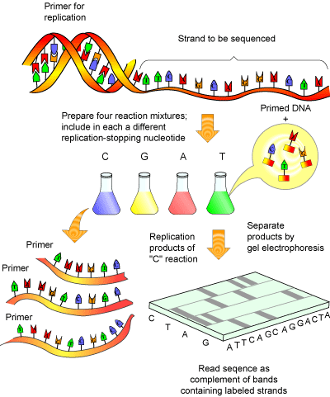
Sanger Method
Developed by Frederick Sanger in 1977
Most popular and predominant method for DNA Sequencing for decades
Can read up to 2000 bps
Slow and expensive
Labor intensive
Human Genome Project was completed using Sanger Sequencing

Slide 8


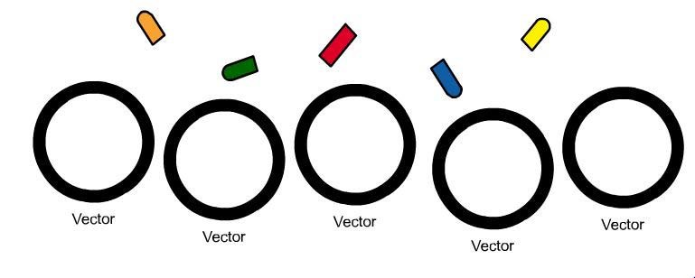
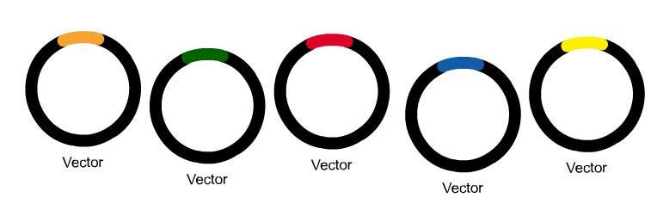

Step 1 - DNA Preperation
1
Cut DNA into a smaller piece for sequencing
Insert into Plasmid
Insert Plasmid inside Bacteria Cell and let it multiply
Extract all the necessary Plasmids and from Plasmid, isolate the DNA for sequencing
2
3
4

Slide 9
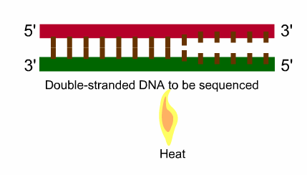
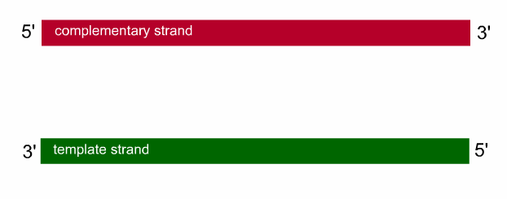
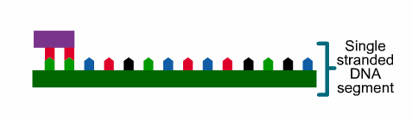


Step 2 –Sequencing Reaction
Strand Separation
- Heat DNA in 96º C (denaturation)
Primer Annealing
- Lower temperature to 50º C (annealing)
- Primer binds to DNA
Primer Extension
- Increase temperature to 60º C
- DNA Polymerase binds to Primer
- Add complementary bases (dNTP) after Primer until terminator base is added (ddNTP)
Termination
- Terminate chain after ddNTP is added
- ddNTP is fluorescently labelled (different colors for A, T, G, C)
1.
2.
3.
4.

Slide 10
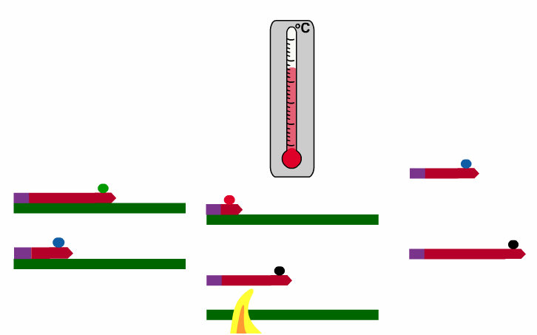
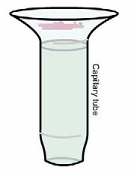
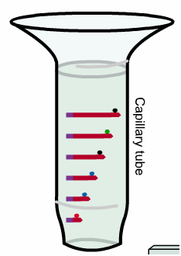
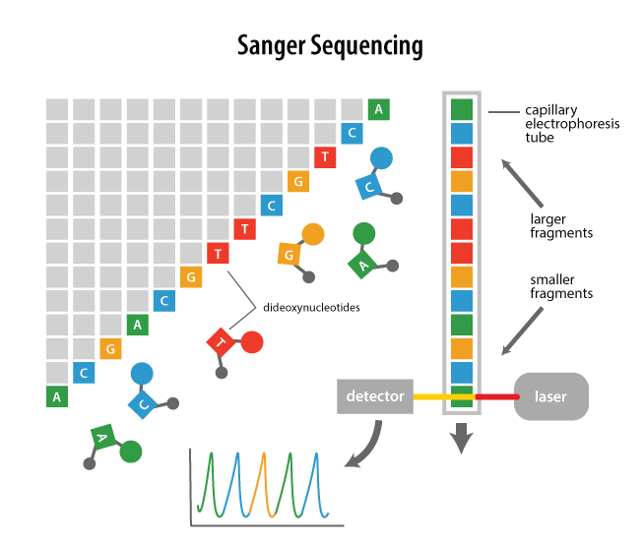
Step 3 – Electrophoresis in Capillary
Sort the newly synthesized DNA strands by length (নতুন সংশ্লেষিত ডিএনএ স্ট্র্যান্ডগুলি দৈর্ঘ্য অনুসারে সাজান) Strands are loaded inside a capillary tube
An electrical negative charge pulls positively charged DNA strands through the capillary
Emerged strands pass through a laser beam that excites the ddNTP fluorescent dye at the end of each strand
Beam causes dye to glow in a specific wavelength/color which is captured by photocell and stored in a computer
Computer than maps each color to each nucleotide sequentially and generates final sequence output

Slide 11
3. Second / Next Gen Sequencing
Less Costly methods, mostly Short Read Sequences, High number of reads

Slide 12
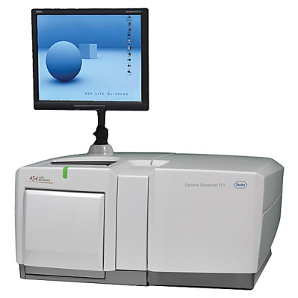
454/Roche (2005)
Pyrosequencing technique
Long Read Sequencing (length up to 700 bps)
Accuracy 99.9%
Can sequence up to 1 Million reads/run
Fast (around 24 hours/run)
Expensive (costs around $10 per 1 million base)

Slide 13
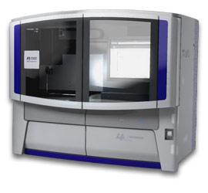
ABI SOLiD (2006)
SOLiD (Sequence by Ligation)
Short Read Sequencing (length up to 100 bps)
Accuracy 99.9%
Can sequence up to 1.4 Billion reads/run
Time around 1-2 weeks, Slower than other sequencers
Cheap (costs around $0.13 per 1 million base)

Slide 14
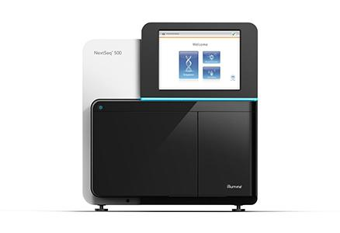
Illumina / Solexa (2007)
Sequencing by Synthesis
Short Read Sequencing (length up to 300 bps)
Accuracy 99.9%
Can sequence up to 3 Billion reads/run
Moderately Slow (around 1-11 days/run)
Expensive Equipment, run cost is low (costs around $0.05-$0.15)

Slide 15
4. Third / Next-Next Gen Sequencing
Long reads, Higher error rate

Slide 16
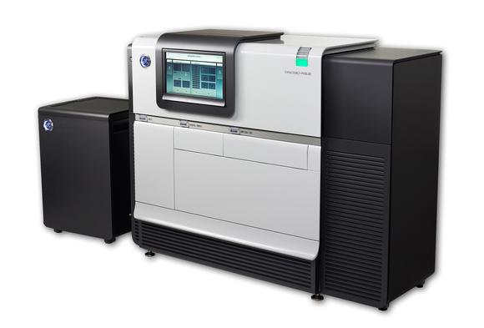
Pacific Biosciences (PacBio)
Single Molecule Real Time Sequencing
Long Read Sequencing (length up to 40,000 bps)
Accuracy 87%
Can sequence up to 500-1000 Mega reads/run
Time around 30 minutes – 4 hours, Faster
Expensive Equipment, run cost is low (costs around $0.13-$0.60)

Slide 17
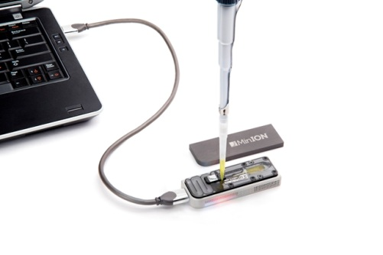
Oxford Nanopore
Nanopore sequencing
Very Long Read Sequencing (length up 500 kb), Portable
Accuracy 92-97%
Depends on read length selected by user
Time around 1 minutes – 48 hours, Faster
Expensive Equipment, run cost is low (costs around $500-$999 per flow cell)

Slide 18
5. Miscellaneous Terms
Some comparisons, terms etc.

Slide 19
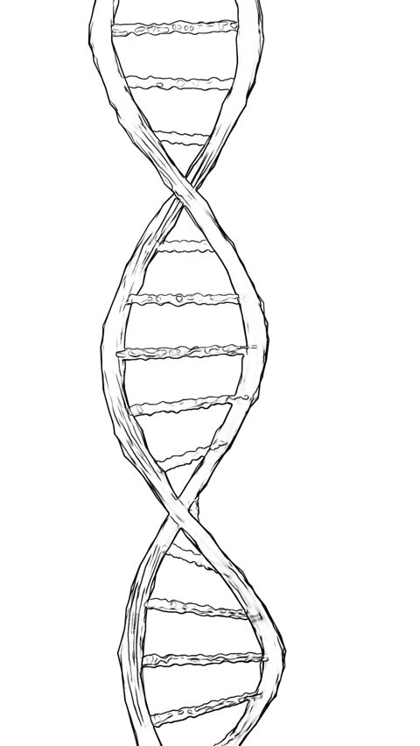
Oligonucleotide
Short sequences of DNA or RNA
Typically less than 20bp
Oligonucleotide of ‘k’ bases length is called k-mer.

Slide 20
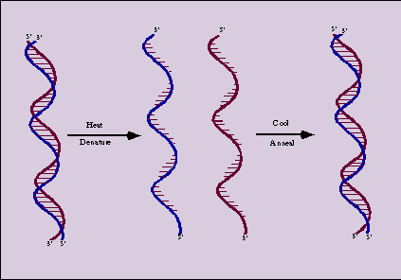
Denaturation and Annealing
Denaturation - Energy of heat pull apart two DNA strands - Happens at a critical temperature denoted T_{m}
Annealing
- Decrease temperature, and strands are joined back together
- Only complementary bases will bond

Slide 21
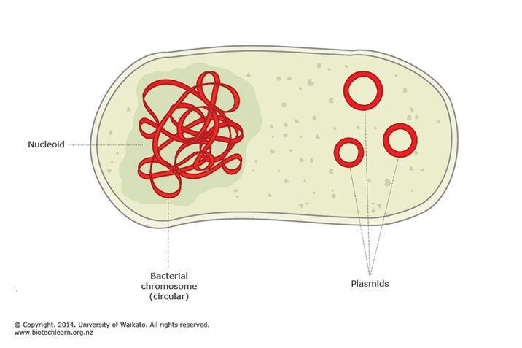
Plasmid
Small, circular piece of DNA often found in bacteria.
Sizes of 2.5-20 kb
Plasmid using method -
* Isolate them in large quantities
* Cut and splice them, adding whatever DNA needed
* Put them back into bacteria, where they'll replicate along with the bacteria's own DNA
* Isolate them again - getting billions of copies of whatever DNA was inserted into the plasmid

Slide 22
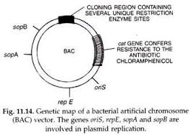
Bacterial Artificial Chromosome (BAC)
Used like a plasmid
BACs carry DNA from humans or mice or any other living being, and is inserted into a host bacterium for replication
BAC is artificially constructed, unlike Plasmid

Slide 23
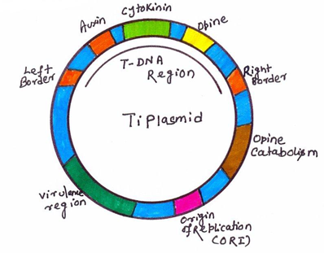
Cloning Vector
A cloning vector is a small piece of DNA, taken from a virus, a plasmid, or the cell of a higher organism, that can be stably maintained in an organism, and into which a foreign DNA fragment can be inserted for cloning purposes.

Slide 24
8%
700 Terabytes
50 Years Time
Of Human DNA is made of Ancient Viruses
Data can be stored in 1gm DNA
Type entire human genome at a speed of 60 wpm
99.9%
Human DNA is identical, 0.01% creates human diversity

Slide 25
Impressed?
TO BE CONTINUED

Slide 26
Youtube Links
Sanger Sequencing - https://www.youtube.com/watch?v=ONGdehkB8jU

